Slide 1

Fairness Through Awareness
Presented By Amir H. Malekijoo

Slide 2

Fairness Through Awareness
What is the definition of Fairness?
How do we protect sensitive information from MISUSE?
Which Domain? Advertising, Insurance, Health Care, etc.
ex. Ethnic, religious, medical, geographic
P.S. In this presentation, an overview of the paper entitled ”Fairness Through Awareness” is given [1]. (all credit goes to authors of the paper)

Slide 3



Sample Space
Flip a coin: {H, T}
Space are Discrete and Continuous
Every space V has possible metrics d(x, y)
How do we prevent sensitive information that
M(x)
x
d(x, y)
y
M(y)
M: V ∆(o)
V: individuals
O: outcomes

Slide 4

1. Introduction

Slide 5
Discriminations
Existing Discrimination examples
Redlining
Reverse Tokenism
Self-fulfilling Prophecy
Blatant Explicit Discrimination
Disproportionately High Segmentation (G Redlining)
Discrimination Based on Redundant Encoding
Fairness Through Blindness

Slide 6
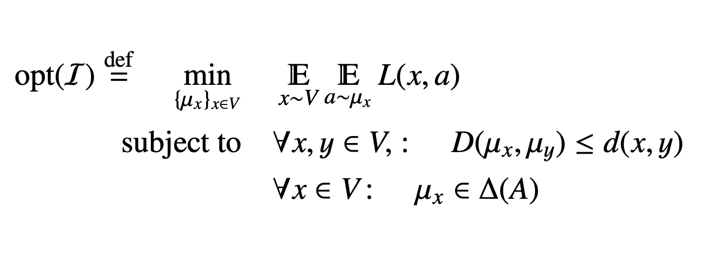
Objective
Data owner
Vendor
The following Objective is a linear Programming.
Ultimate Goal: Achieving Fairness
Goal1: Achieving Fairness in Classification
Goal2: Minimize Vendor’s Loss Function
M(x)
a₂
x
d(x, y)
y
M(y)
a₅
M: V ∆(o)
f: O A
V: individuals
O: outcome space
A: action space

Slide 7

2. Key Elements

Slide 8
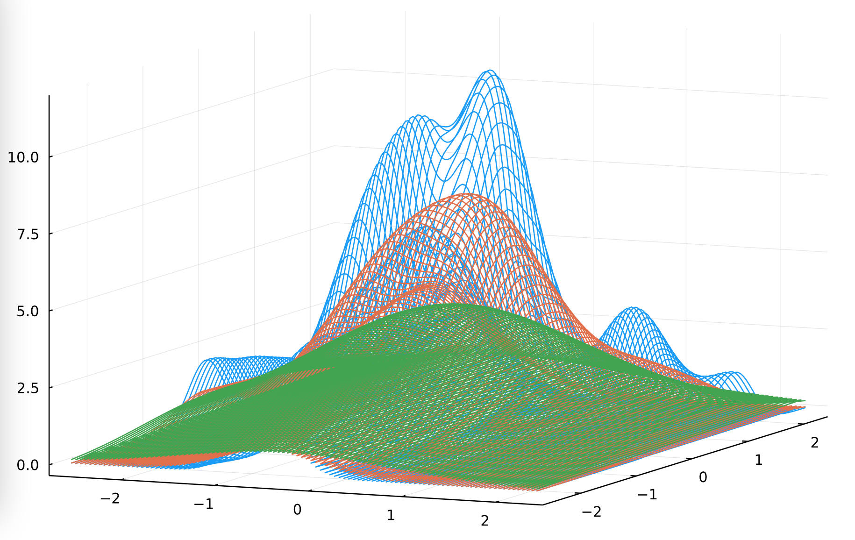
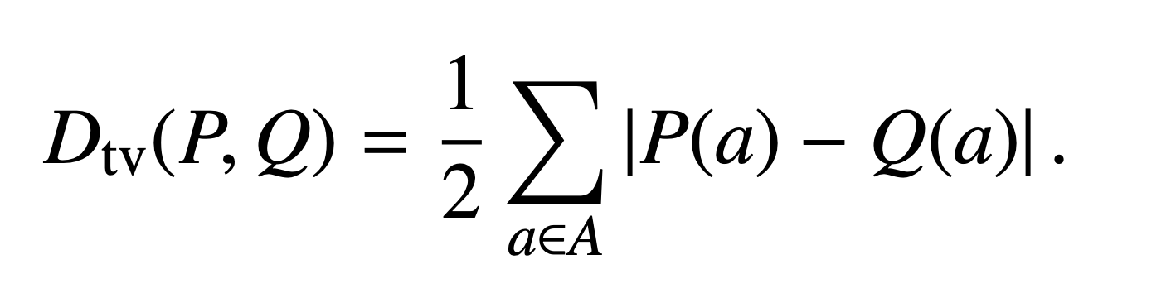
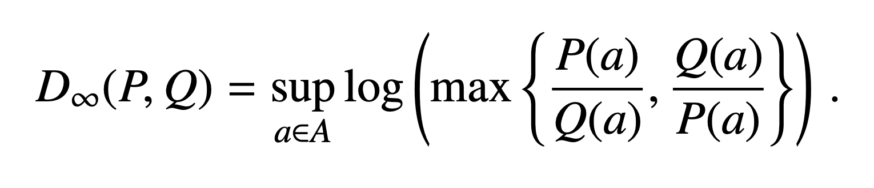
Distance Metrics
A metric on a set X is a function d : X × X → R For all x, y, z in X, this function is required to satisfy the following conditions:
d(x, y) ≥ 0 (non-negativity)
d(x, y) = 0 iff x = y (identity of indiscernible)
d(x, y) = d(y, x) (symmetry)
d(x, z) ≤ d(x, y) + d(y, z) (subadditivity/triangle inequality).
Note: Lipschitz condition is linear when using statistical distance
ST Example: P, Q denote probability measures on a domain A. A= {0,1}
P(0) = P(1) = ½, Q(0) = ¾, Q(1) = ¼
D(P, Q) = ¼

Slide 9
Group Fairness Approach
Statistical Parity = Group Fairness, Demographic parity
Equalize two groups S, T at the level of outcomes
Pr[outcome o | S] = Pr [outcome o | T]
mapping M : V → ∆(A) satisfies statistical parity between
distributions S and T up to bias ε if
D_{tv}(μ_{S} , μ_{T} ) ≤ ε
SP neutralizes redundant encodings.
Discrimination That SP will not cover.
fairness through blindness
Self-fulfilling prophecy.
Subset Targeting.
Demographic parity, also referred to as statistical parity, acceptance rate parity and benchmarking. A classifier satisfies this definition if the subjects in the protected and unprotected groups have equal probability of being assigned to the positive predicted class.
Statistical parity is a natural way to model equity: members of each group have the same chance of receiving the favorable output.

Slide 10
Individual Fairness
Treat similar individuals similarly
We formulize the above sentence with
Lipschitz Condition
Metric d: V × V ℝ+
Lipschitz condition:
|M(X) - M(y)| ≤ d(x, y)
M(x)
x
d(x, y)
M(y)
y
M: V ∆(o)
V: individuals
O: outcomes

Slide 11

Distributional Outcomes
Outcomes can be Distribution not Discrete.
M(x)
x
d(x, y)
M(y)
y
M: V ∆(o)
V: individuals
O: outcomes

Slide 12



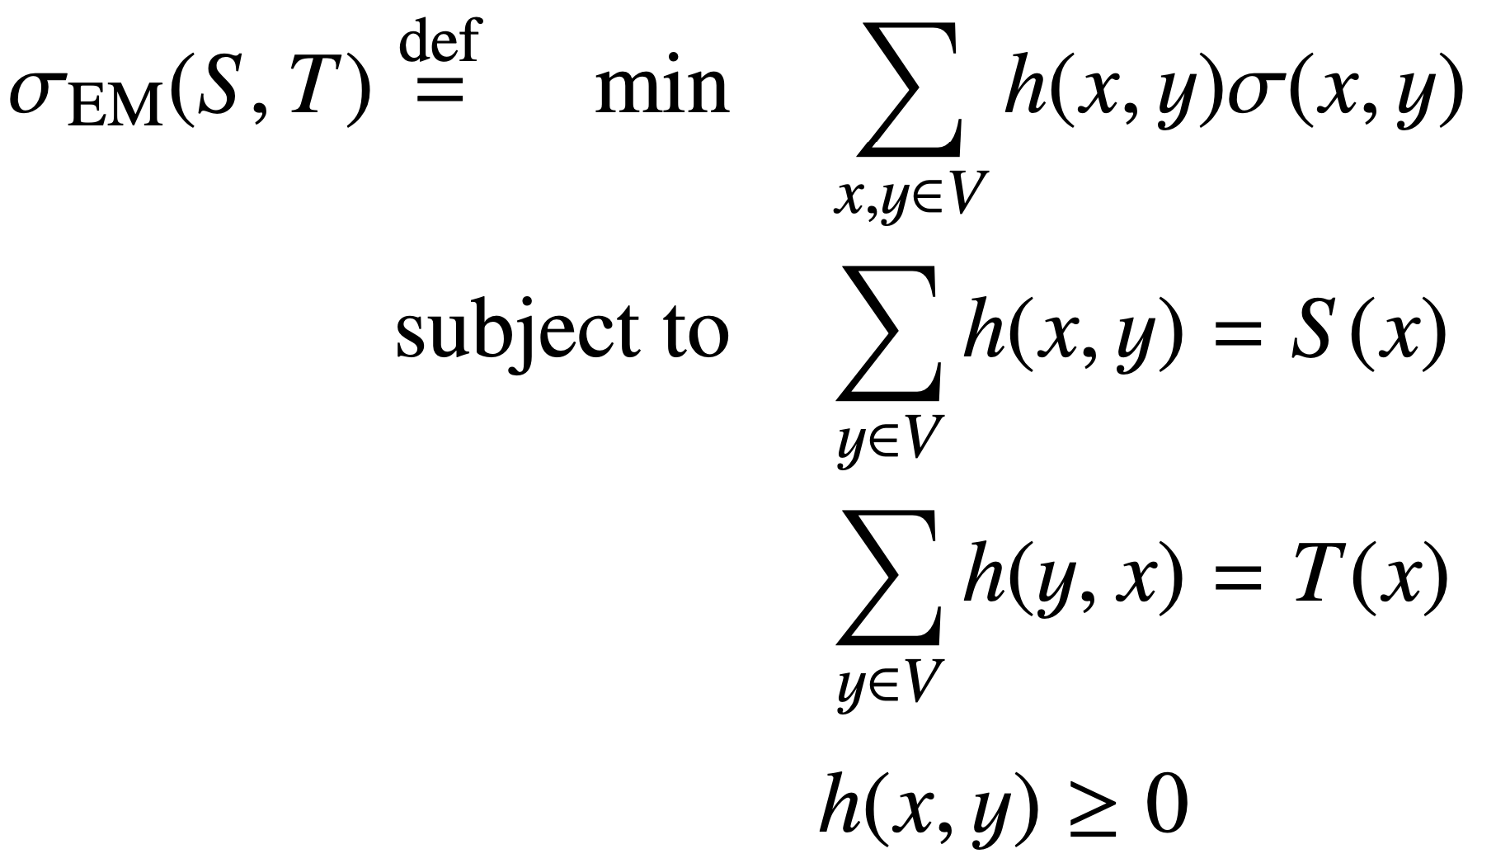
Earthmover Distance
Let σ : V × V → ℝ+ (nonnegative distance function)
The σ-Earthmover distance between two
distributions S and T, LP:

Slide 13

3. Overview

Slide 14
1. LiP vs. SP.
statistical parity is insufficient as a general notion of fairness.
When Lipschitz condition implies statistical parity between two distributions S and T on V?
What extent to which any Lipschitz mapping can violate statistical parity?

Slide 15
1. LP vs. SP.
Def 3.2: bias_{D,d}(S,T) = max μ_{S}(0)−μ_{T}(0),
Lemma 3.1. Let D ∈ {D_{tv}, D∞} and let M : V → ∆(A) be any (D, d)-Lipschitz mapping. Then, M satisfies statistical parity between S and T up to biasD,d (S , T ).
Using Linear Programming and its duality interpretation the following theorem will be proved.
Theorem 3.3:
biasD_{tv,d}(S,T) ≤ d_{EM}(S,T).
Conclusion: when S and T are “similar” then the Lipschitz condition implies statistical parity
P.S. biasDtv,d(S,T) is a relaxation of biasD∞,d(S,T). biasD∞,d(S,T) ≤ biasDtv,d(S,T).
So D∞ can be proved in a same way as Dtv . Hence, every (D∞, d)-Lipschitz mapping is also (Dtv , d)-Lipschitz.

Slide 16
2. Differential Privacy
fairness is a generalization of the notion of differential privacy
database curator maintains a database x ⊆U
data analyst is allowed to ask a query F: V → A on the database.
M : V → ∆(A) satisfies ε-differential privacy iff M satisfies the (D∞, d)-Lipschitz property.
Section 5:
Theorem: Fairness mechanism with “high utility” in metric spaces (V,d) of bounded doubling dimension
|B(x,R)| ≤ O(|B(x,2R))
Based on exponential mechanism

Slide 17

3. Fair Affirmative Action

Slide 18
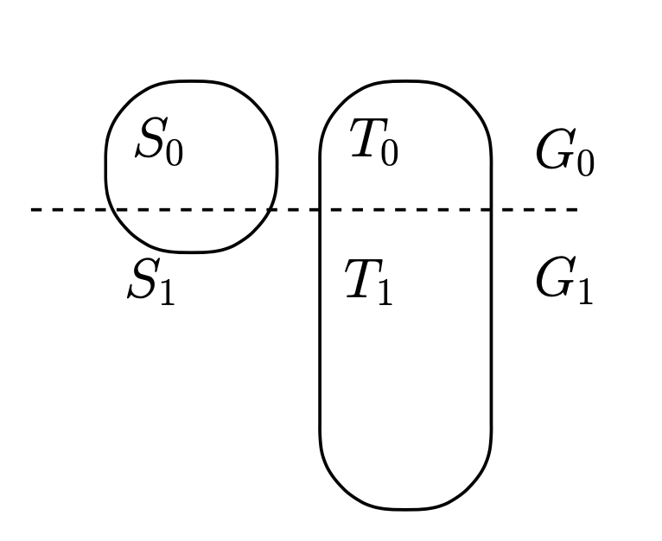
3. Fair Affirmative Action
What if we want to ensure statistical parity between two groups S and T, but members of S are less likely to be “qualified”?
What if earthmover distance large?
Here we consider the complementary case where S and T are very different and imposing statistical parity corresponds to preferential treatment.
For simplicity, let T = S^{c}.

Slide 19
3. Fair Affirmative Action
What if we want to ensure statistical parity between two groups S and T, but members of S are less likely to be “qualified”?
Or equally, What if earthmover distance large?
Here we consider the complementary case where S and T are very different and imposing statistical parity corresponds to preferential treatment.
For simplicity, let T = S^{c}.
S
T = S^{c}
S₀
T₀
G₀
S₁
T₁
G₁

Slide 20
3. Fair Affirmative Action
1. All in Gi treated the same
S
T = S^{c}
S₀
T₀
G₀
S₁
T₁
G₁

Slide 21
3. Fair Affirmative Action
All in G_{i} treated the same
Statistical Parity, the probability of S₀ must be the same as T₁
Unless the distribution is unbalanced.
Imposing Statistical Parity. (Collapse)
(Lipschitz Condition makes it collapse)(solution: assigning a fixed probability distribution) Yellow oval
Failing to Impose Statistical Parity. (blatant discrimination)
(only T is chosen by vendor) Green oval
S
T = S^{c}
S₀
T₀
G₀
S₁
T₁
G₁

Slide 22
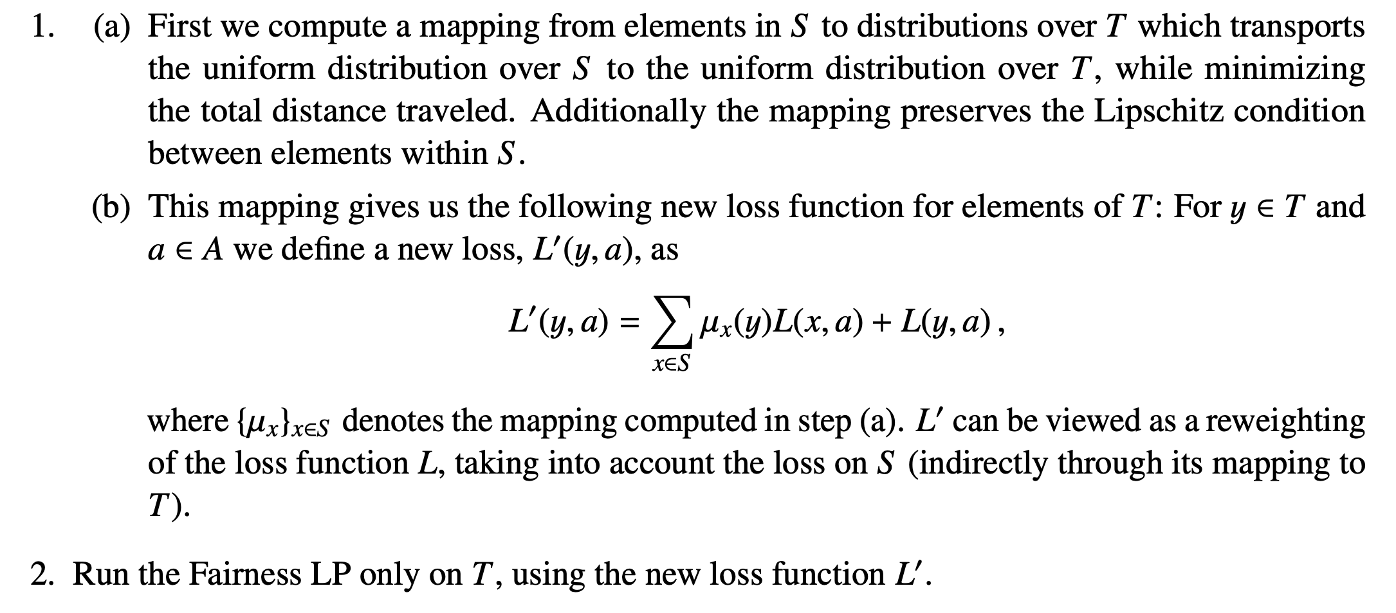
3. Fair Affirmative Action

Slide 23
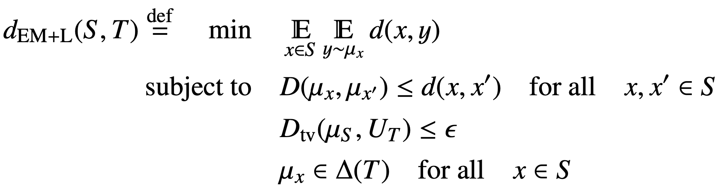
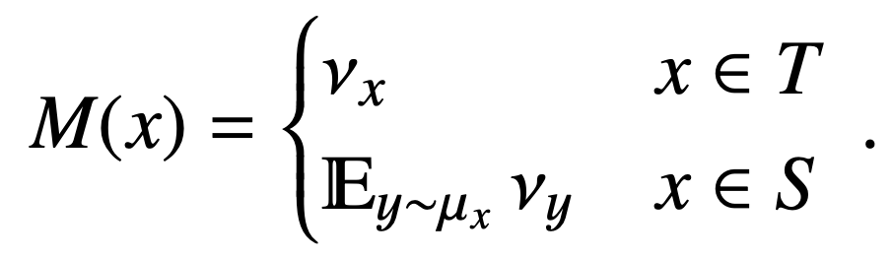
3. Fair Affirmative Action

Slide 24
3. Fair Affirmative Action
Trade-off between Imposing and failure to impose SP
Mapping
EM Distance
M(x)
M(y)
M: V ∆(o)
S
T
Outcomes

Slide 25

Summary

Slide 26
Summary
Group fairness
Individual fairness
Relationship between GF & IF
Group fairness does not imply individual fairness
Individual fairness implies group fairness if earthmover distance small
Fair Affirmative Action

Slide 27
References
[1] Cynthia Dwork, Moritz Hardt, Toniann Pitassi, Omer Reingold, Richard Zemel, ”Fairness Through Awareness”, arXiv:1104.3913v2, (2011). https://doi.org/10.48550/arxiv.1104.3913

Slide 28
Fair Use Notice
This suppository and the content made available are for educational and informational purposes ONLY. This presentation may refer copyrighted material owned by a third party. If you wish to use copyrighted material mentioned to this repository for your own purposes that go beyond fair use, you must obtain permission from the copyright owner.

